Slide 1
FACE RECOGNITION WITH MASK
Project Guide,
Dr. Vandana B S
By,
Rachana S N 4VP17CS048
Tejaswini Shreedhar Gouda 4VP17CS080
Theertha A V 4VP17CS082
Vaishnavi 4VP17CS084

Slide 2
ABSTRACT
The COVID-19 is an unparalleled crisis leading to huge number of casualties and security problems. In order to reduce the spread of coronavirus, people often wear masks to protect themselves. This makes the face recognition a very difficult task since certain parts of the face are hidden.
In our project, we propose a reliable method based on discarding the masked region and deep learning based features in order to address the problem of masked face recognition process.

Slide 3
CONTENT
Introduction
Objectives
Methodology
Expected Outcomes
Applications
Literature Survey
Comparison with Existing Systems
Proposed System
Requirements Specification & Analysis
Functional, Non-Functional, Hardware & Software Requirements
Screenshots
Conclusion
References

Slide 4
INTRODUCTION
Our project focuses on two concepts, namely: face mask recognition and masked face recognition.
The first one checks whether the person is wearing a mask or not. This can be applied in public places where the mask is compulsory.
The second one aims to recognize a face, in presence of mask, based on the eyes and the forehead regions.

Slide 5
OBJECTIVES
The main purpose of our project is to recognize the face with mask.
Distinguish between whether the face is masked or not.
To evaluate how mask impact the performance of various facial recognitions system across the globe.
Face recognition is more safer than the other technique since the person can be recognized without contact of any of the devices.

Slide 6
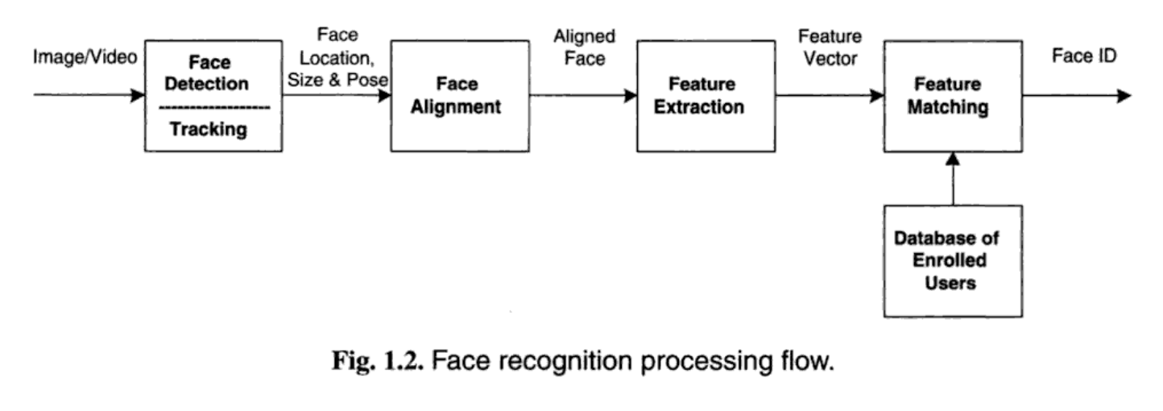
BLOCK DIAGRAM

Slide 7
METHODOLOGY
Many approaches have been proposed to handle this problem.
We can classify them into three categories namely: local matching approach, restoration approach and discard occlusion based approach.
We are using Quantization based pooling method to recognize the face.

Slide 8
Steps
Localizing the mask region.
Obtaining the informative region from the masked face.
Feature extraction layer.
We extract deep features using VGG–16 face CNN descriptor from the 2D images.
Deep bag of features layer.
Fully connected layer and classification.
Multilayer Perceptron Classifier(MLP)
Back Propagation Algorithm.

Slide 9
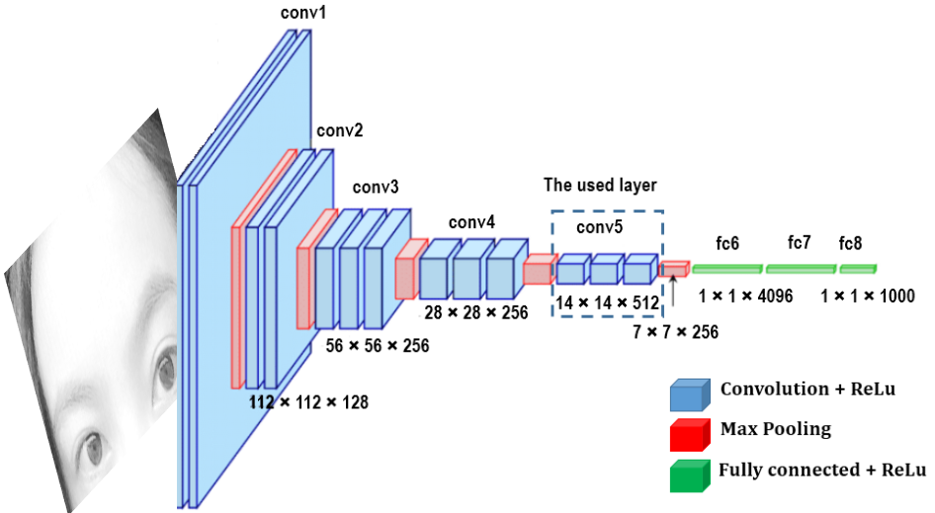
VGG-16 network architecture.

Slide 10
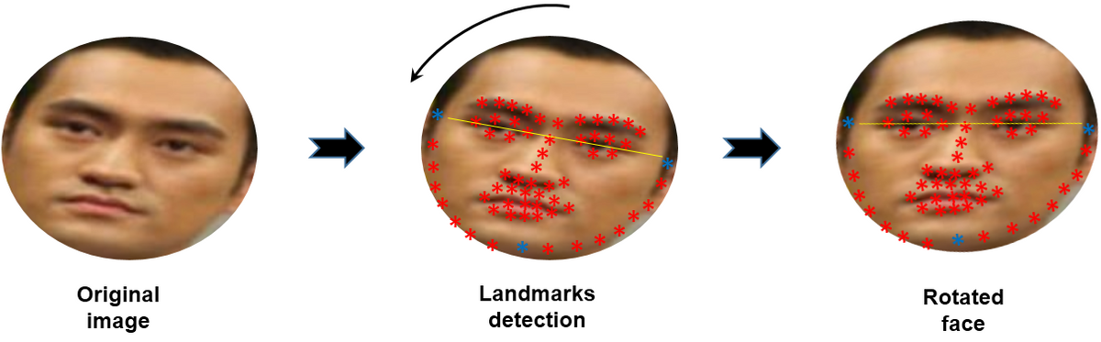
2D Face rotation.

Slide 11
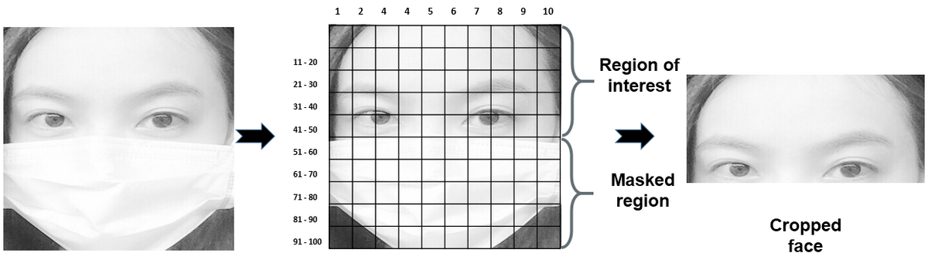
Sampling the masked face image into 100 regions of the same size and cropping filter.

Slide 12
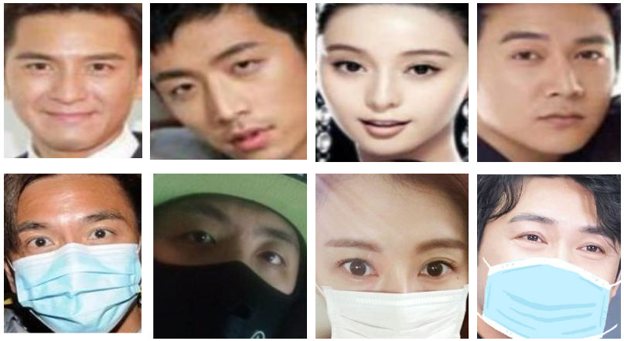
Pairs of face images from RMFRD dataset: face images without mask (up) and their corresponding face images with mask (down).

Slide 13
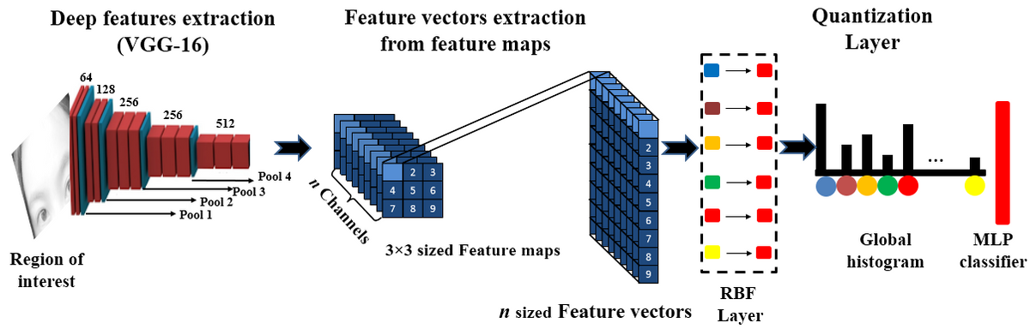
Overview of the proposed method.

Slide 14
EXPECTED OUTCOME
Our project addresses the problem of masked face recognition during COVID-19 pandemic.
It takes the clues from the landmarks around eyes, eyebrows and the hairline, and recognizes the face.
Final outcome of this project will be an Android application, which recognizes the face.

Slide 15
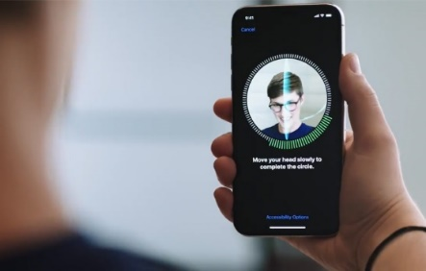
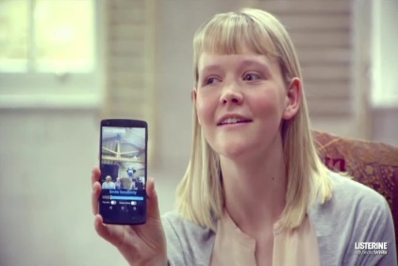

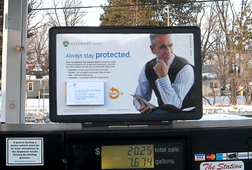
APPLICATIONS
Face masks are one of the best defense against the spread of COVID-19, but their growing adoption is having the unintended effects.
Unlocking the phones.
To find missing person.
Track school attendance.
Protect law enforcement
Identify people on social media platforms.

Slide 16
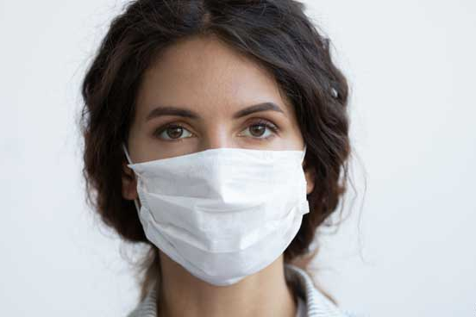
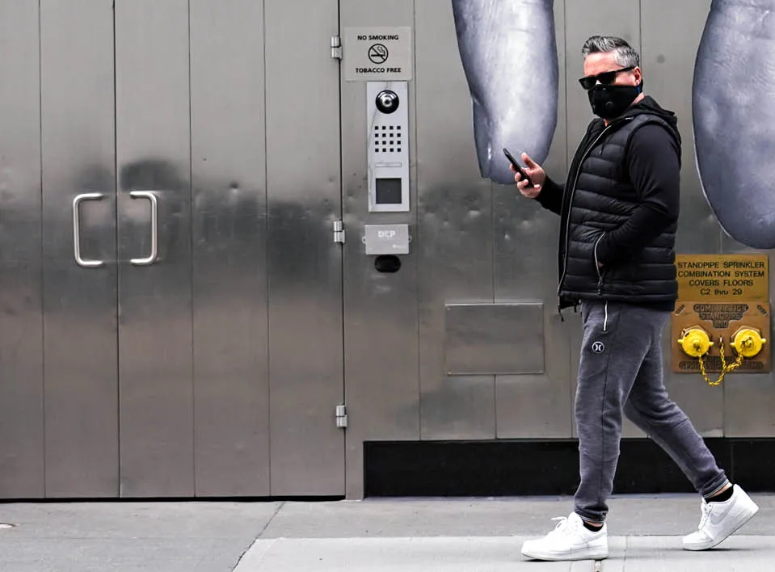
Fraudsters and thieves take advantage of the mask, stealing and committing crimes without being identified.
Community access control and face authentication becomes very difficult when a large part of the face is hidden by a mask.
Facilitate secure transaction.
Wearing a face mask validates identity at the ATM.

Slide 17
LITERATURE SURVEY
Title: A Novel GAN-Based Network for Unmasking of Masked Face, 2020
Authors: U. Din, K. Javed, S. Bae, and J. Yi. IEEE Access
two stages of the project
-mask object detection and
-image completion of the removed mask region
dataset
-paired synthetic dataset using publicly available CelebA dataset
CNN(VGG-19) produces a feature vector for each proposed region.
-Finally, SVM classifies the presence of the object within that candidate region
accuray:86.4%

Slide 18
Title: IEEE paper on Face Recognition Using Light-Convolutional Neural Networks Based on Modified VGG16 Model, 2020
Author: Anugrah Bintang Perdana and Adhi Prahara, Informatics Department Universitas Ahmad Dahlan Yogyakarta, Indonesia
VGG-16 algorithm used and accuracy of VGG16 is 77.8%
The proposed light-CNN is compact yet produces good performances with 94.4% accuracy.
dataset: YouTube faces dataset
The experiment shows result 99.63% and 95.12% accuracy from LFW and YouTube Faces dataset.

Slide 19
Title: Towards Facial Recognition Problem in COVID-19 Pandemic, 2020 4th International Conference on Electrical, Telecommunication and Computer Engineering (ELTICOM) 210
Authors: Imran Qayyum Mundial, M. Sohaib Ul Hassan, M Islam Tiwana, Waqar Shahid Qureshi and Eisa Alanazi.
dataset: VGGFACE2 dataset.
accuracy: model’s accuracy is 97.35% on the Labeled Faces in the wild (LFW) dataset, produced model given 99% accuracy
Feature Extractor CNN and SVM classifier

Slide 20
Title: Periocular Recognition in the Wild: Implementation of RGB-OCLBCP Dual-Stream CNN , 2018
Authors: Leslie Ching Ow Tiong, Yunli Lee and Andrew Beng Jin Teoh.
this paper proposes an RGB-OCLBCP dual-stream convolutional neural network, which accepts an RGB ocular image and a colour-based texture descriptor, namely Orthogonal Combination-Local Binary Coded Pattern (OCLBCP) for periocular recognition in the wild.
dataset: Three publicly accessible databases, namely AR, CASIA-iris distance and UBIPr, have been used to evaluate the proposed network.
dual-stream Convolutional Neural Network (CNN)
accuracy 95%

Slide 21
Title: Dynamic feature matching for partial face recognition, 2018
Authors: He, H. Li, Q. Zhang, and Z. Sun.
This paper proposes a novel partial face recognition approach, called dynamic feature matching (DFM), which combines fully convolutional networks and sparse representation classification (SRC) to address partial face recognition problem regardless of various face sizes
dataset: Gallery images from the LFW
FCN( Fully Convolutional Network) algorithm method used for this.
accuracy : 70.52% for single scale DFM and 76.16% for multi scale DFM.

Slide 22
Title: Topology Preserving Structural Matching for Automatic Partial Face Recognition, 2018
Authors: Y. Duan, J. Lu, J. Feng, and J. Zhou.
method
- a topology preserving graph matching (TPGM) method for partial face recognition
- CNN algorithm
- This paper is an extended version of their conference paper. There are several new contributions:
They exploited higher order topological information to enhance the robustness of the transformation, where TPGM becomes a special case of the new TPSM.
They extracted the SiftSurfSILBPCNN descriptor rather than SiftSurfSILBP to present stronger discriminative power.
They conducted additional experiments on EYB and holistic face recognition settings of LFW and PubFig to show the effectiveness of the proposed methods.
- The proposed “SiftSurfSILBPCNN” combines the advantages of SIFT, SURF, SILBP and CNN, showing robustness to rotation, scale and illumination, which is important for keypoint description.
dataset: Labeled Face in the Wild (LFW), PubFig, AR and Extended Yale B (EYB)
accuracy:74.33%

Slide 23
Title: High-Speed Face Recognition Based on Discrete Cosine Transform and RBF Neural Networks, 2005
Authors: Meng Joo Er, Weilong Chen, and Shiqian Wu, Member, IEEE.
In this paper, an efficient method for high-speed face recognition based on the discrete cosine transform (DCT), the Fisher’s linear discriminant (FLD) and radial basis function (RBF) neural networks is presented.
Discrete transform cosine is applied for dimensionality reduction and then the selected low-frequency DCT coefficient vectors are fed into a multilayer perceptron (MLP) classifier , Fisher’s linear discriminant and radial belief network(RBF)
dataset:
The Olivetti Research Laboratory (ORL) database;
The FERET database;
The Yale database.

Slide 24
COMPARISON WITH EXISTING SYSTEMS
Face recognition has a long history. The human face is not an ideal modality compared to other biometric traits; it is typically less precise than other biometric modalities such as iris or fingerprint. However, the face has the advantages that make it one of the most favored biometric characteristics for identity recognition.
Because of artificial intelligence technologies, significant advances in face recognition have occurred.
In early times, research interests were mainly focused on face recognition under controlled conditions where simple classical approaches provided excellent performance.
Today, the focus of research is on unconstrained conditions in which deep learning technology has gained more popularity as it offers strong robustness against the numerous variations that can alter the recognition process.

Slide 25
PROPOSED SYSTEM
Our project focuses on detecting the presence or absence of the mask using the VGG-16 model.
Then the face is recognized by training the model in using the dataset with the key features such as eyes, eyebrows and hairline.
Based on the masked face dataset, we will be able to build face recognition algorithms to help identify people wearing masks traveling in and out of communities or facilities that require identity verification.

Slide 26
REQUIREMENTS
Functional Requirements :
Dataset
Deep learning methodology
Android Technology
Non Functional Requirements :
Availability
Portability
Maintainability

Slide 27
Hardware Requirements :
Processor - Intel Pentium onwards Compatible Hardware.
RAM - 4 GB.
Hard Disk - 3 GB (minimum).
Camera
Keyboard
Software Requirements :
Operating System -Windows (7 and above), Ubuntu
Anaconda Navigator
Software - Jupyter Notebook, Google Colab, Android Studio

Slide 28

SCREENSHOTS
Face Recognition without Mask.

Slide 29
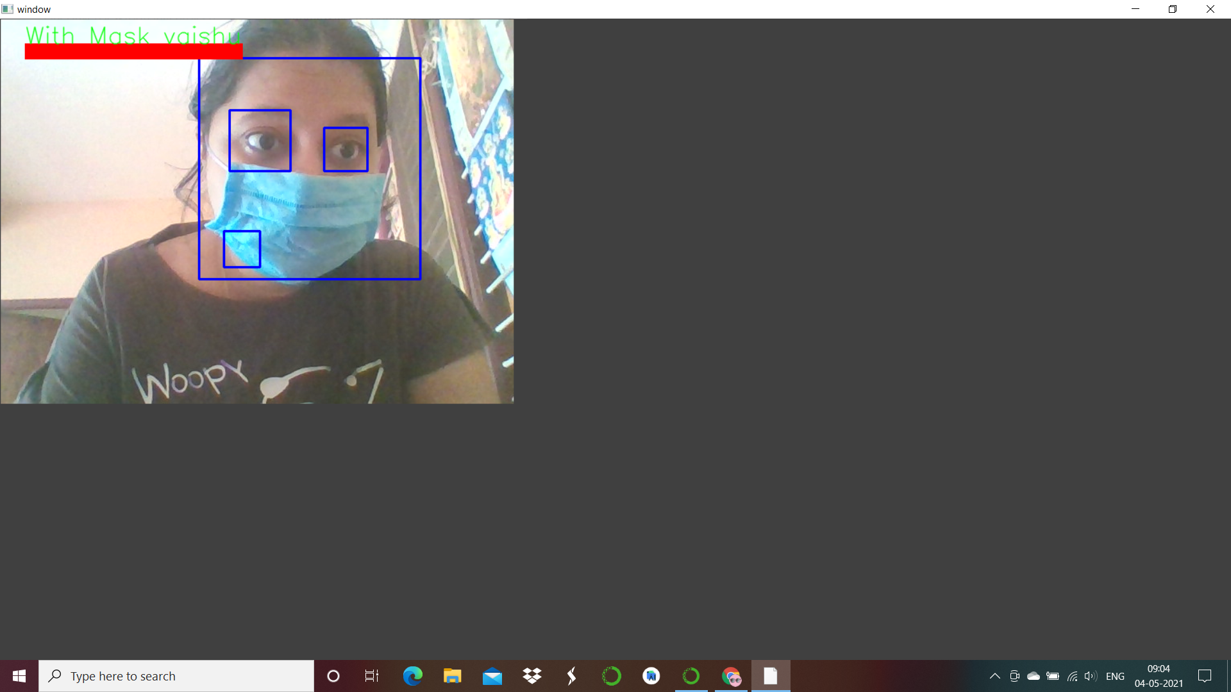
Face Recognition Mask.

Slide 30
CONCLUSION
In real-world scenarios, human faces might be occluded by other objects such as facial mask. This makes the face recognition process a very challenging task.
Consequently, current face recognition methods will easily fail to make an efficient recognition.
The proposed method improves the generalization of face recognition process in the presence of the mask. To accomplish this task, we proposed a deep learning based method and quantization based technique to deal with the recognition of the masked faces.

Slide 31
REFERENCES
U. Din, K. Javed, S. Bae, and J. Yi. A novel gan-based network for unmasking of masked face. IEEE Access, 8:44276–44287, 2020.
Duan, J. Lu, J. Feng, and J. Zhou. Topology preserving structural matching for automatic partial face recognition. IEEE Transactions on Information Forensics and Security, 13(7):1823–1837, 2018.
He, H. Li, Q. Zhang, and Z. Sun. Dynamic feature matching for partial face recognition. IEEE Transactions on Image Processing, 2018.
Towards Facial Recognition Problem in COVID-19 Pandemic, 2020 4th International Conference on Electrical, Telecommunication and Computer Engineering (ELTICOM) 210

Slide 32
Periocular Recognition in the Wild: Implementation of RGB-OCLBCP Dual-Stream CNN by Leslie Ching Ow Tiong, Yunli Lee and Andrew Beng Jin Teoh
IEEE paper on Eigenfaces vs. Fisherfaces: Recognition Using Class Specific Linear Projection by Peter N. Belhumeur, Joao P. Hespanha, and David J. Kriegman
High-Speed Face Recognition Based on Discrete Cosine Transform and RBF Neural Networks by Meng Joo Er, Member, IEEE, Weilong Chen, and Shiqian Wu, Member, IEEE
Face Recognition with Facial Mask Application and Neural Networks by Marco Grassi1 and Marcos Faundez-Zanuy
IEEE paper on Face Recognition Using Light-Convolutional Neural Networks Based on Modified VGG16 Model by Anugrah Bintang Perdana, Adhi Prahara Informatics Department Universitas Ahmad Dahlan Yogyakarta, Indonesia

Slide 33
Thank You!!

